Slide 1
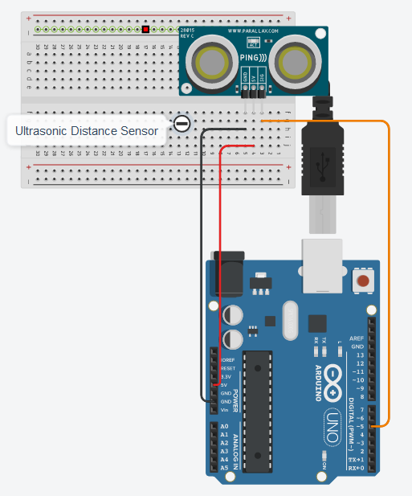
CS341 Lab 7:
Velocity and Distance
https://github.com/whittyh/CS341

Slide 2
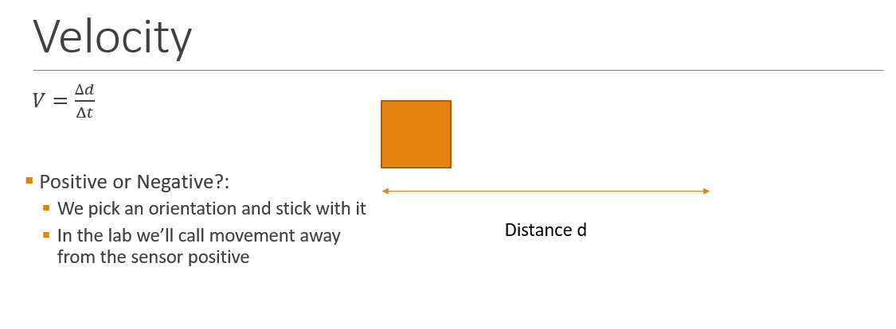
Lab 7 Objectives:
Use an ultrasonic sensor to calculate the velocity of an object passing in front of the sensor
Interface with ultrasonic sensor

Slide 3
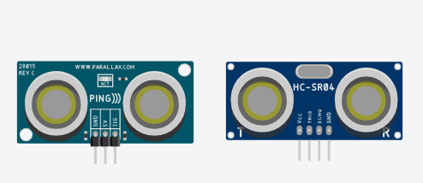
Ultrasonic Sensor:
Digital sensor that sends and receives high frequency ‘ultrasonic’ sound waves, commonly called Sonar
Send ‘ping’, wait a fixed time interval, read ‘echo’
Two common styles, 3 and 4 pin. We use 3 pins
On 3 pin sensors the ping and echo are written and read through the same pin, while 4 pins have separate ping and echo pins.

Slide 4
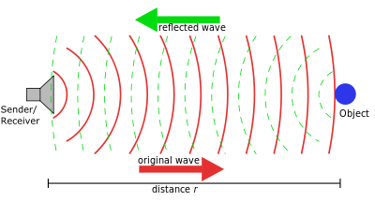
Visualizing Sonar:

Slide 5
Approach:
Complete circuit and implement the following logic in the loop:
Loop()
{
delay(24); // small delay between loops
d = ping(pingPin); // read distance
delay(DELTA_T); // delay 1 second
// calculate distance again (d2)
// v = (d2 –d)/(time) (note: time = 1)
// print distance 1, distance 2, and the velocity
}

Slide 6
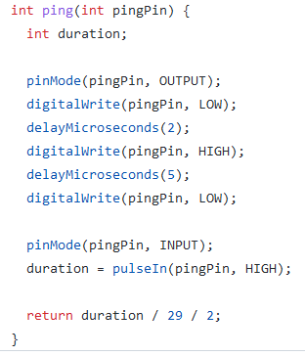
Observe how the ping function works:
(note you shouldn’t change this code)
// set pingPin to write (OUTPUT)
// set low for 2 microseconds
// set high for 5 microseconds
// set low again
// change pinmode to read (INPUT)
// use pulseIn function to return time // taken to receive ‘echo’
// divide time by 29, then by 2 to return correct distance

Slide 7
Overview:
Use ping function already written to do the following in the loop:
Read distance
Wait 1 second
Read distance again
Use V = ∆D/ ∆T

